Slide 1
CST1510 Programming for Data Communication and Networks

Slide 2
Learning outcomes: knowledge
On successful completion of this module, the student will be able to:
Explain the core principles of Python programming — including data types, control structures, functions, and object-oriented design — and their role in constructing reliable, maintainable software.
Describe how applications store, retrieve, and process data through files, databases, and web APIs, and identify appropriate tools and structures for a given data-handling task.
Identify common security vulnerabilities in software applications including insecure password storage and SQL injection — and explain the principles behind secure, industry-standard mitigation practices.

Slide 3
Learning outcomes: skills
On successful completion of this module, the student will be able to:
  Design and implement Python programs that apply control structures, functions, and object-oriented design to construct systematic solutions to problems drawn from AI/Data Science, Cyber Security, and IT.
  Employ data handling, processing, and visualisation techniques — using tools such as pandas, web APIs, and SQL — to extract, structure, and present meaningful information from real-world data sources.
  Construct, test, and deploy a working, interactive Streamlit application that incorporates secure authentication practice, demonstrating professional, industry-relevant development standards.

Slide 4
Syllabus
Python Fundamentals: Values, Types, and Input/Output.
Decision-Making and Iteration (Control Flow).
Functions, Parameters, and Modular Code Design.
Lists, Dictionaries, Files, and Error Handling.
Object-Oriented Programming: Classes and Objects.
Data Analysis with Pandas.
String Manipulation and Text Processing.
Working with Real-World Data and Web APIs.
Hashing, Password Security, and Authentication.
Relational Databases and SQL.
Building Interactive Dashboards with Streamlit.
AI Integration, Testing, and Deployment.

Slide 5
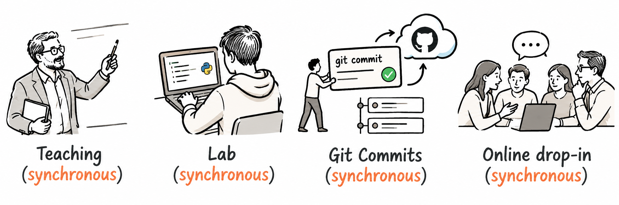
CST1510 is a 30-credit module
Each week:
2-hour workshop (demonstration, concept, do it yourself)
3-hour lab that reinforces your learning, with a GitHub commit and push at the end of every lab
1-hour online drop-in session (Q&A, formative feedback, further discussion)

Slide 6
Teaching team
LONDON
Anna Wieclaw
Room TG17
+44 208 411 4547
a.wieclaw@mdx.ac.uk
LONDON
Ahmed Eissa
A.Eissa@mdx.ac.uk
MAURITIUS
Aisha Idoo
a.idoo@mdx.ac.mu

Slide 7
Your weekly routine
Check MyLearning each week
Your weekly learning materials and activities will be released on MyLearning during the relevant teaching week.
To keep up with the module:
Check MyLearning at the start of each week for new materials, instructions and resources.
Work through the current week's content and complete the associated lab activities.
Make regular Git commits as you complete your work. This provides a clear record of your progress throughout the module.
Attend the scheduled sessions — teaching, labs and online drop-ins. Your timetable on MyLearning will show the dates, times and locations.
Your weekly routine:
Check MyLearning → Attend Teaching → Complete Lab → Commit to Git → Ask for Help

Slide 8
Academic integrity: GenAI and ChatGPT
The aim of this module is to develop your own understanding of programming. AI can support your learning, but it must not replace the process of learning how to think, solve problems and understand code.
Learn the fundamentals yourself first. Approach the weekly material, examples, problems and tasks without using GenAI.
Handwritten notes MUST be your own. The required handwritten learning notes must be physically handwritten and completed individually. They provide evidence that you have personally worked through the fundamental concepts.
Limited AI support is permitted during development. Once you have worked through the fundamentals, you may use light/assistive AI support, including permitted AI tools integrated into your IDE, to support your learning and development.
You must understand your code. AI should help you learn, debug and develop — it should not produce work that you cannot explain.
You will demonstrate your understanding. The second submission includes a video recording in which you explain your code, how it works, your development decisions and your solution in detail.
The key principle:
Learn it → Write it → Build it → Use AI carefully → Explain it

Slide 9
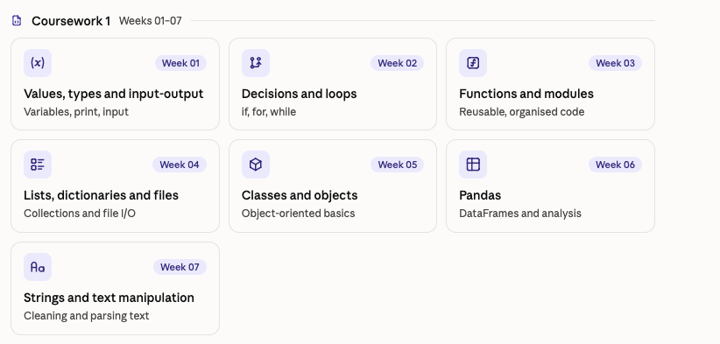

Slide 10
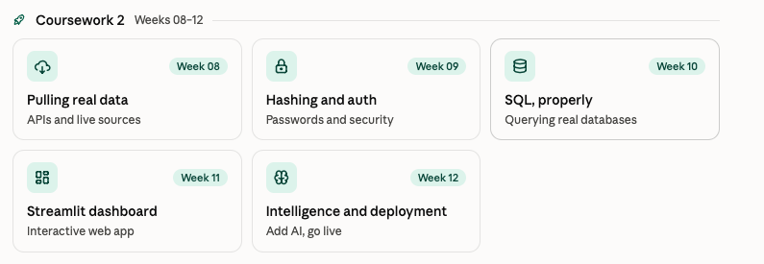

Slide 11



Where each week’s material lives
Every week
CST1510/
├─ Week 00 - Orientation and Setup/
├─ Week 01 - Values, Types and Input-Output/
│ ├─ 01 - Your First Program/
│ ├─ 02 - Variables and Types/
│ ├─ 03 - Numbers and Arithmetic/
│ ├─ 04 - Input, Casting and f-strings/
│ │ ├─ examples/
│ │ └─ W01T04_walkthrough.ipynb
│ ├─ DEMO/record_check.py
│ ├─ LAB/
│ │ ├─ warmup/
│ │ ├─ template.py
│ │ └─ W01_Lab.ipynb
│ ├─ EXTRA_PROJECTS.md
│ └─ README.md
└─ Week 02 … Week 12/
Download
Get the week’s folder from Moodle
Workshop topics
Save
Workshop demo
Put it inside your CST1510 folder
Lab
Push
Optional extras
Commit your lab work to GitHub
Read first
Notes:
Each week, download the new week folder from Moodle and place it inside CST1510, next to the previous weeks. Topic folders 01-04 are the workshop topics, each with examples and a walkthrough notebook. DEMO holds the running demo. LAB holds the warm-up broken files, the mini-project template and the lab notebook. Read README first; EXTRA_PROJECTS is optional.

Slide 12



How a normal week runs
2h
2h
3h
Push
Online session
Workshop
Lab
GitHub
Catch up on the week
Module updates
A running demo first: see the finished version
Four short topics
A “your turn” after every idea
Fix three deliberately broken files
Jupyter notebook drills
Tiered mini-project
A handwritten journal entry
Push your lab results to your own repository
Every week follows this same shape.
Notes:
Walk left to right. Online session is for catch-up and updates. The workshop opens with the running demo before any explanation, then four short topics, each followed by a 'your turn'. The lab starts with three broken files, then the notebook drills, the tiered mini-project and the handwritten journal entry. The week ends with pushing lab work to GitHub.

Slide 13
Online drop-in sessions
Use the weekly online drop-in sessions for additional support, questions and feedback.
Before the drop-in: If you have a question but do not want to ask it during the online session, email your question to me in advance. I can address general questions anonymously so that everyone can benefit from the answer.
During the drop-in: Ask questions about the topics covered in the week's teaching and lab sessions, including problems you encountered while completing your tasks.
Need individual support? If you would prefer to discuss something privately or in person, please see me during my office hours.

Slide 14
Resources
The following are the main learning resources for this module. Use them alongside the weekly teaching materials, lab activities and examples provided on MyLearning.
Mark Lutz — Learning Python
A comprehensive reference for Python programming. Use this book to explore topics in greater depth and reinforce concepts introduced during the module.
Cory Althoff — The Self-Taught Programmer
A practical introduction to programming and professional development. Particularly useful for developing good programming habits and learning how to approach problems independently.
Official Python Documentation — Python.org
The official reference for the Python language and its standard library. You are encouraged to become

Slide 15
What this module expects
• Bring a laptop that is set up — that is what today's session is for.
• Expect errors every week.
  – Each lab starts with broken code on purpose
  – You are not expected to get it right first time
• The Cheat Sheet is handwritten on paper and photographed.
  – Not typed, not copied from a slide, and not generated using GenAI
• The work uses real tools, not toy examples.
  – Real bcrypt hashing, and a SQL injection you exploit and then fix
  – The dashboard you deploy in Week 11 gets a public URL you can use on your CV

Slide 16
Twelve weeks. One app. Your name on it.
You start this module printing one line of text. You finish it sending someone a link to software you built, secured and deployed yourself.
Build it
Python from the ground up — logic, functions, objects, and real data with pandas.
Break it
Hash passwords with bcrypt. Exploit a SQL injection, then close it yourself.
Ship it
Deploy a live dashboard in your lane: AI and Data Science, Cyber Security, or IT.
No toy examples. Twelve weeks of work, in your own GitHub repository, that you can show someone.

Slide 17
Assessments
Formative feedback
Continuous, not tied to fixed checkpoints — feedback happens every week, in the lab session.
Git commit and push must happen after the lab session, or on the same day. This is also your weekly evidence of progress — a tutor can see it was done, in order, on time.
Summative — two courseworks, individual
CW1 (Weeks 1–7): a small, tiered mini-project every week (Threshold / Typical / Excellent), plus the handwritten Cheat Sheet built up one box at a time — evidenced through your weekly GitHub commits.
CW2 (Weeks 8–12): one continuous project in your chosen lane (AI/Data Science, Cyber Security, or IT), grown every week and ending in a deployed Streamlit application with a public URL.
Exact weighting and submission details are set out in the CW1 and CW2 specifications.

Slide 18
Suggestions
Bring your laptop to every teaching and lab session. If needed, you can borrow a Windows laptop from the University.
Set up your software before the module begins. Make sure Python, VS Code, Git and GitHub are installed and working.
Check MyLearning every week. Weekly materials are released alongside the relevant teaching week, and you can use the module handbook and recommended resources to read ahead.
Attend teaching and lab sessions regularly. Aim for 100% attendance — programming is learned through regular practice.
Use the online drop-in sessions. Bring questions, problems or code you would like help understanding.
Complete the weekly lab tasks. The labs are an essential part of the module and will help you prepare for your assessments.
Learn to research solutions. Use the Python documentation, recommended books and reliable online resources, and ask your tutors when you are unsure.
Practise throughout the week. Do not leave programming until the assessment deadline.
Attend → Practise → Make mistakes → Ask questions → Improve

Slide 19
Any questions?

